Slide 1
How Websites & Apps Are Built
And How You Can Do It Too Keith Marshall

Slide 2

You Already Use This
Raise your hand if you use:
TikTok
Instagram
Netflix
All built by developers

Slide 3
What is Web Development?
Frontend = what you see
Backend = logic + data

Slide 4
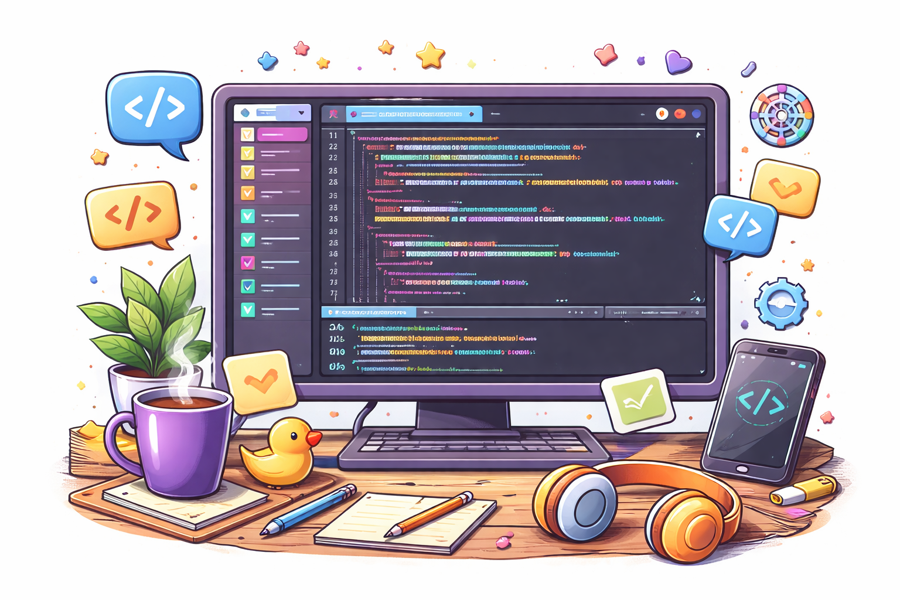
The Stack
HTML = structure
CSS = design
JavaScript = behavior

Slide 5
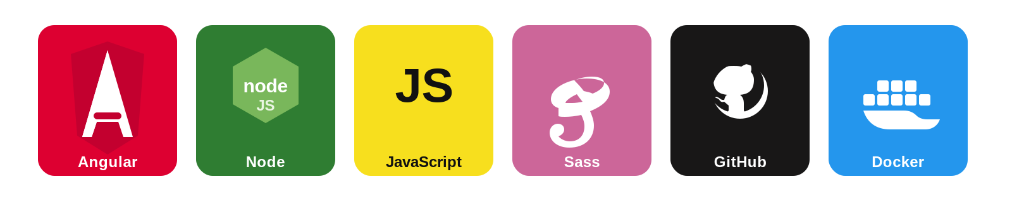
My Tools
Angular
Node.js
JavaScript
Sass
GitHub
Docker

Slide 6
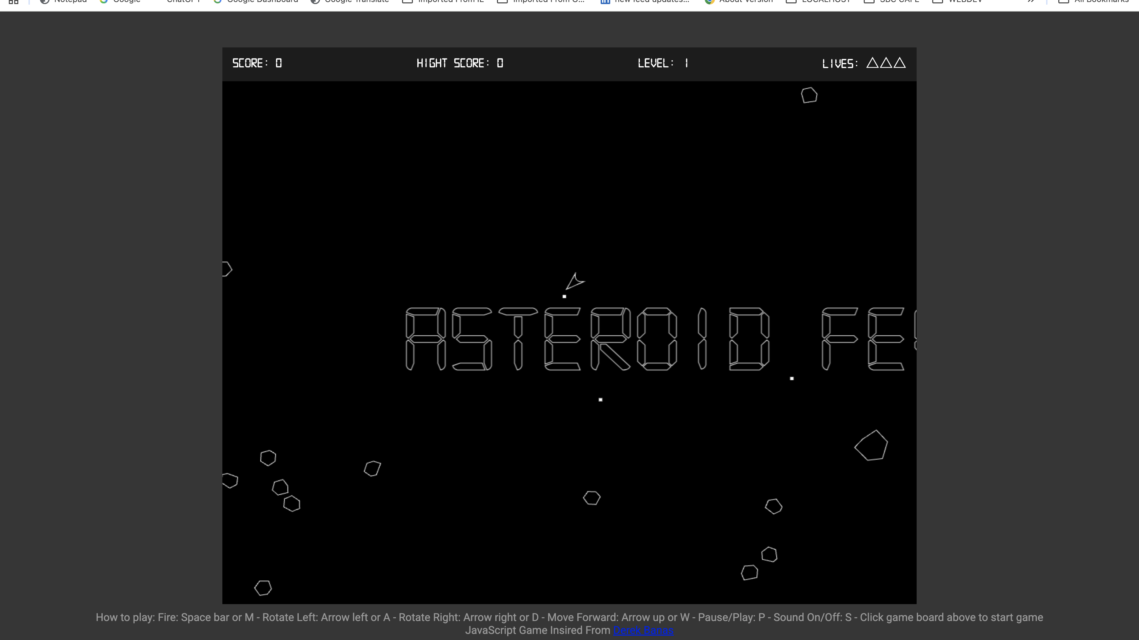

Slide 7
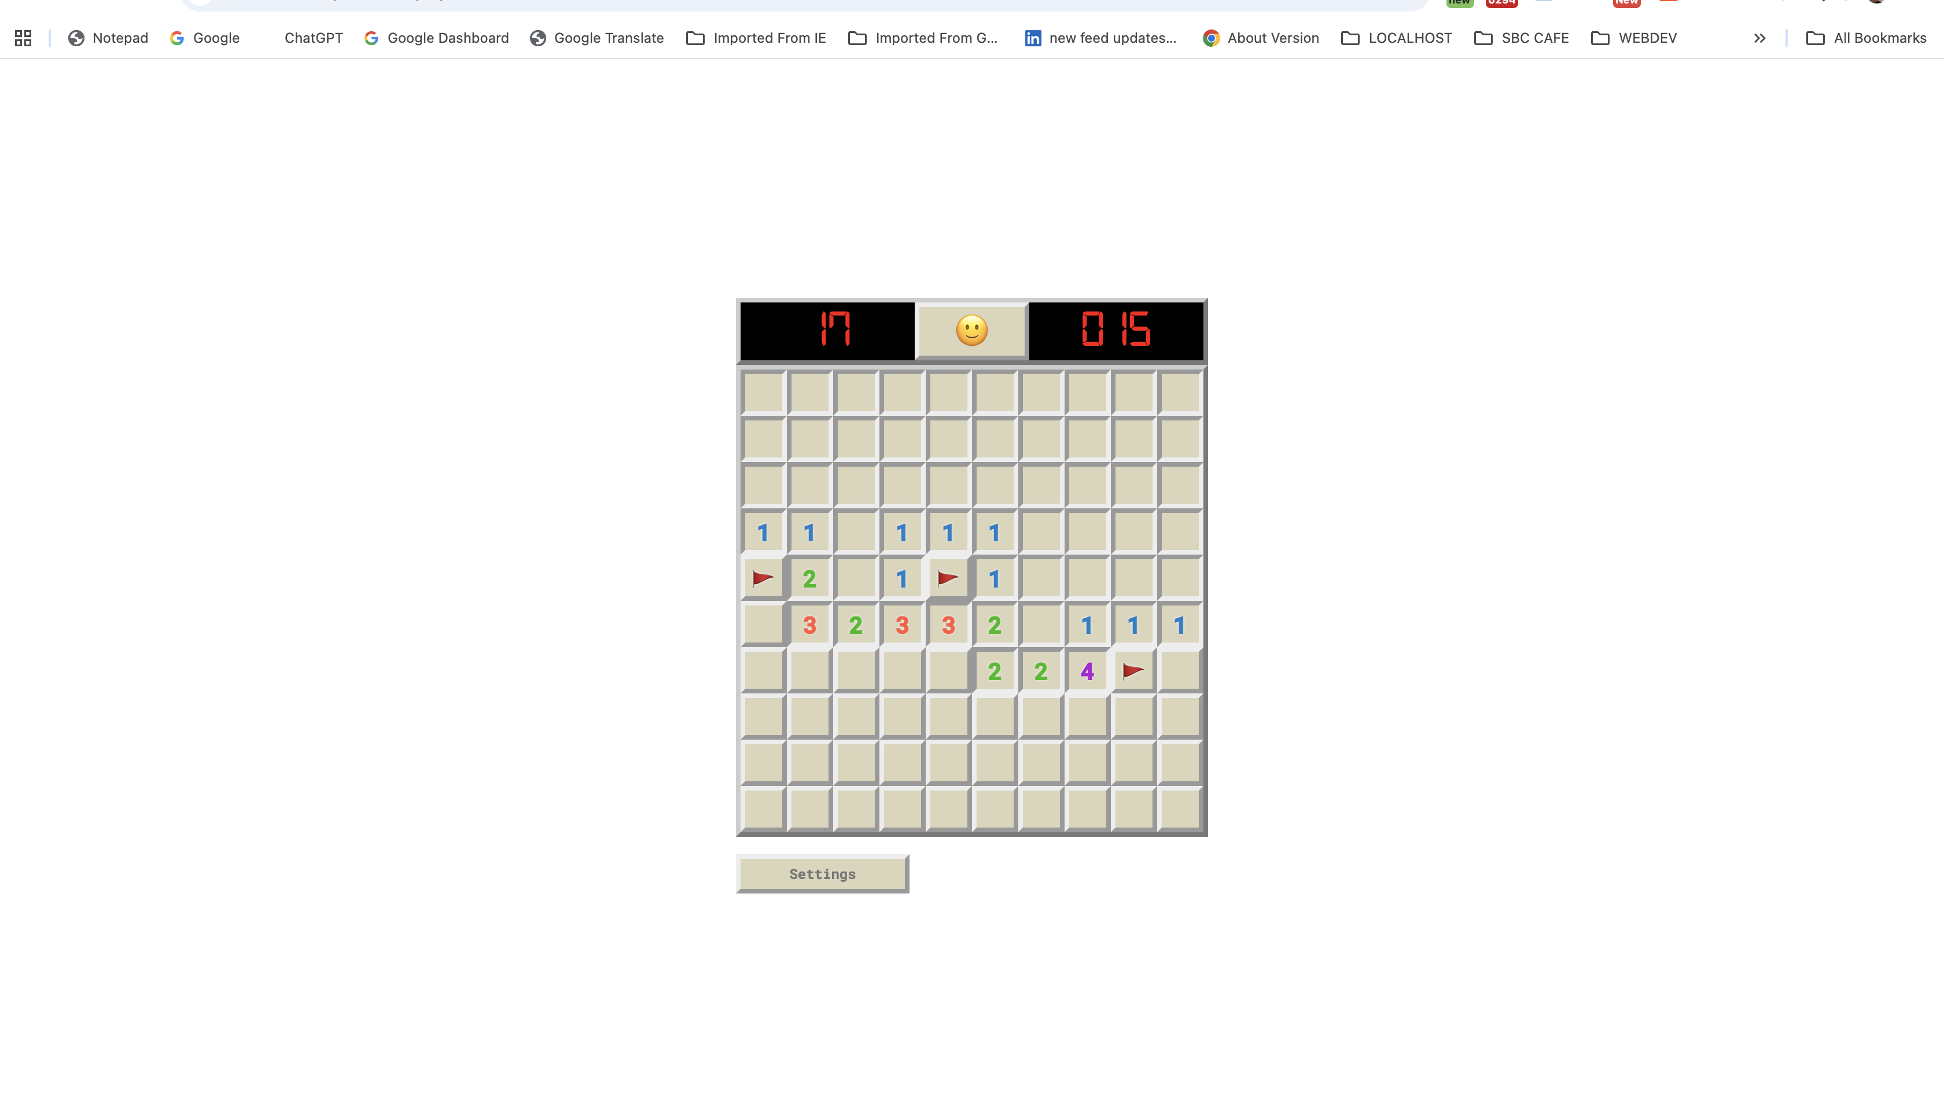

Slide 8
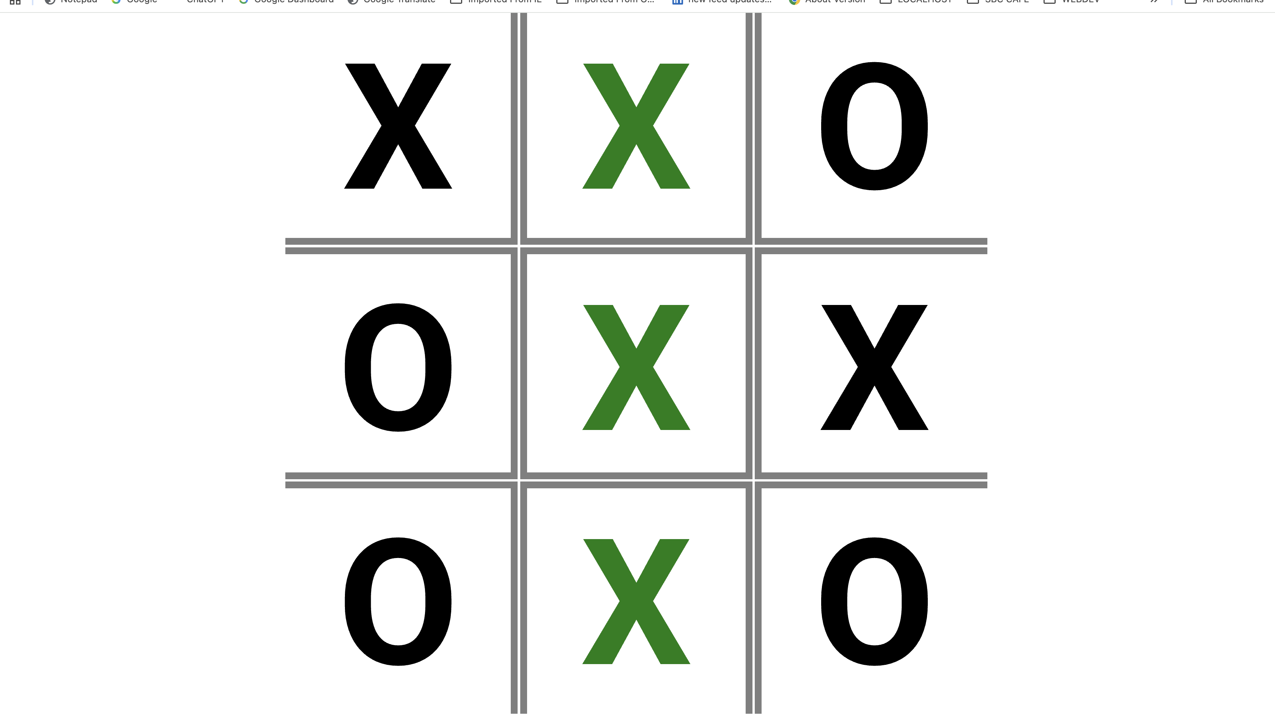

Slide 9
Demo

Slide 10
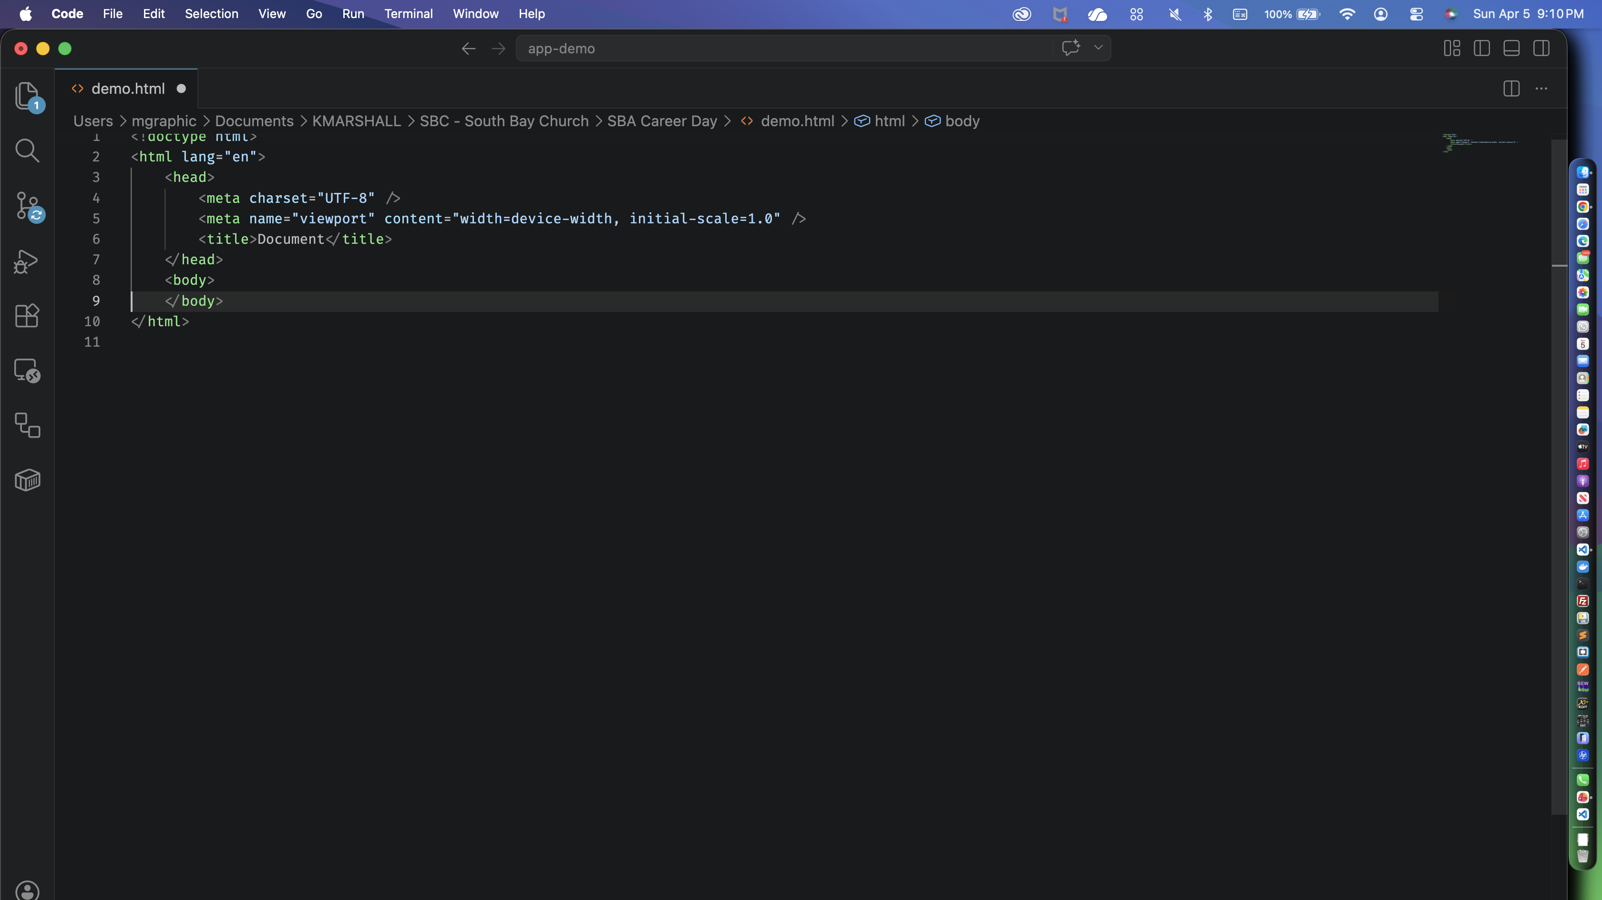

Slide 11
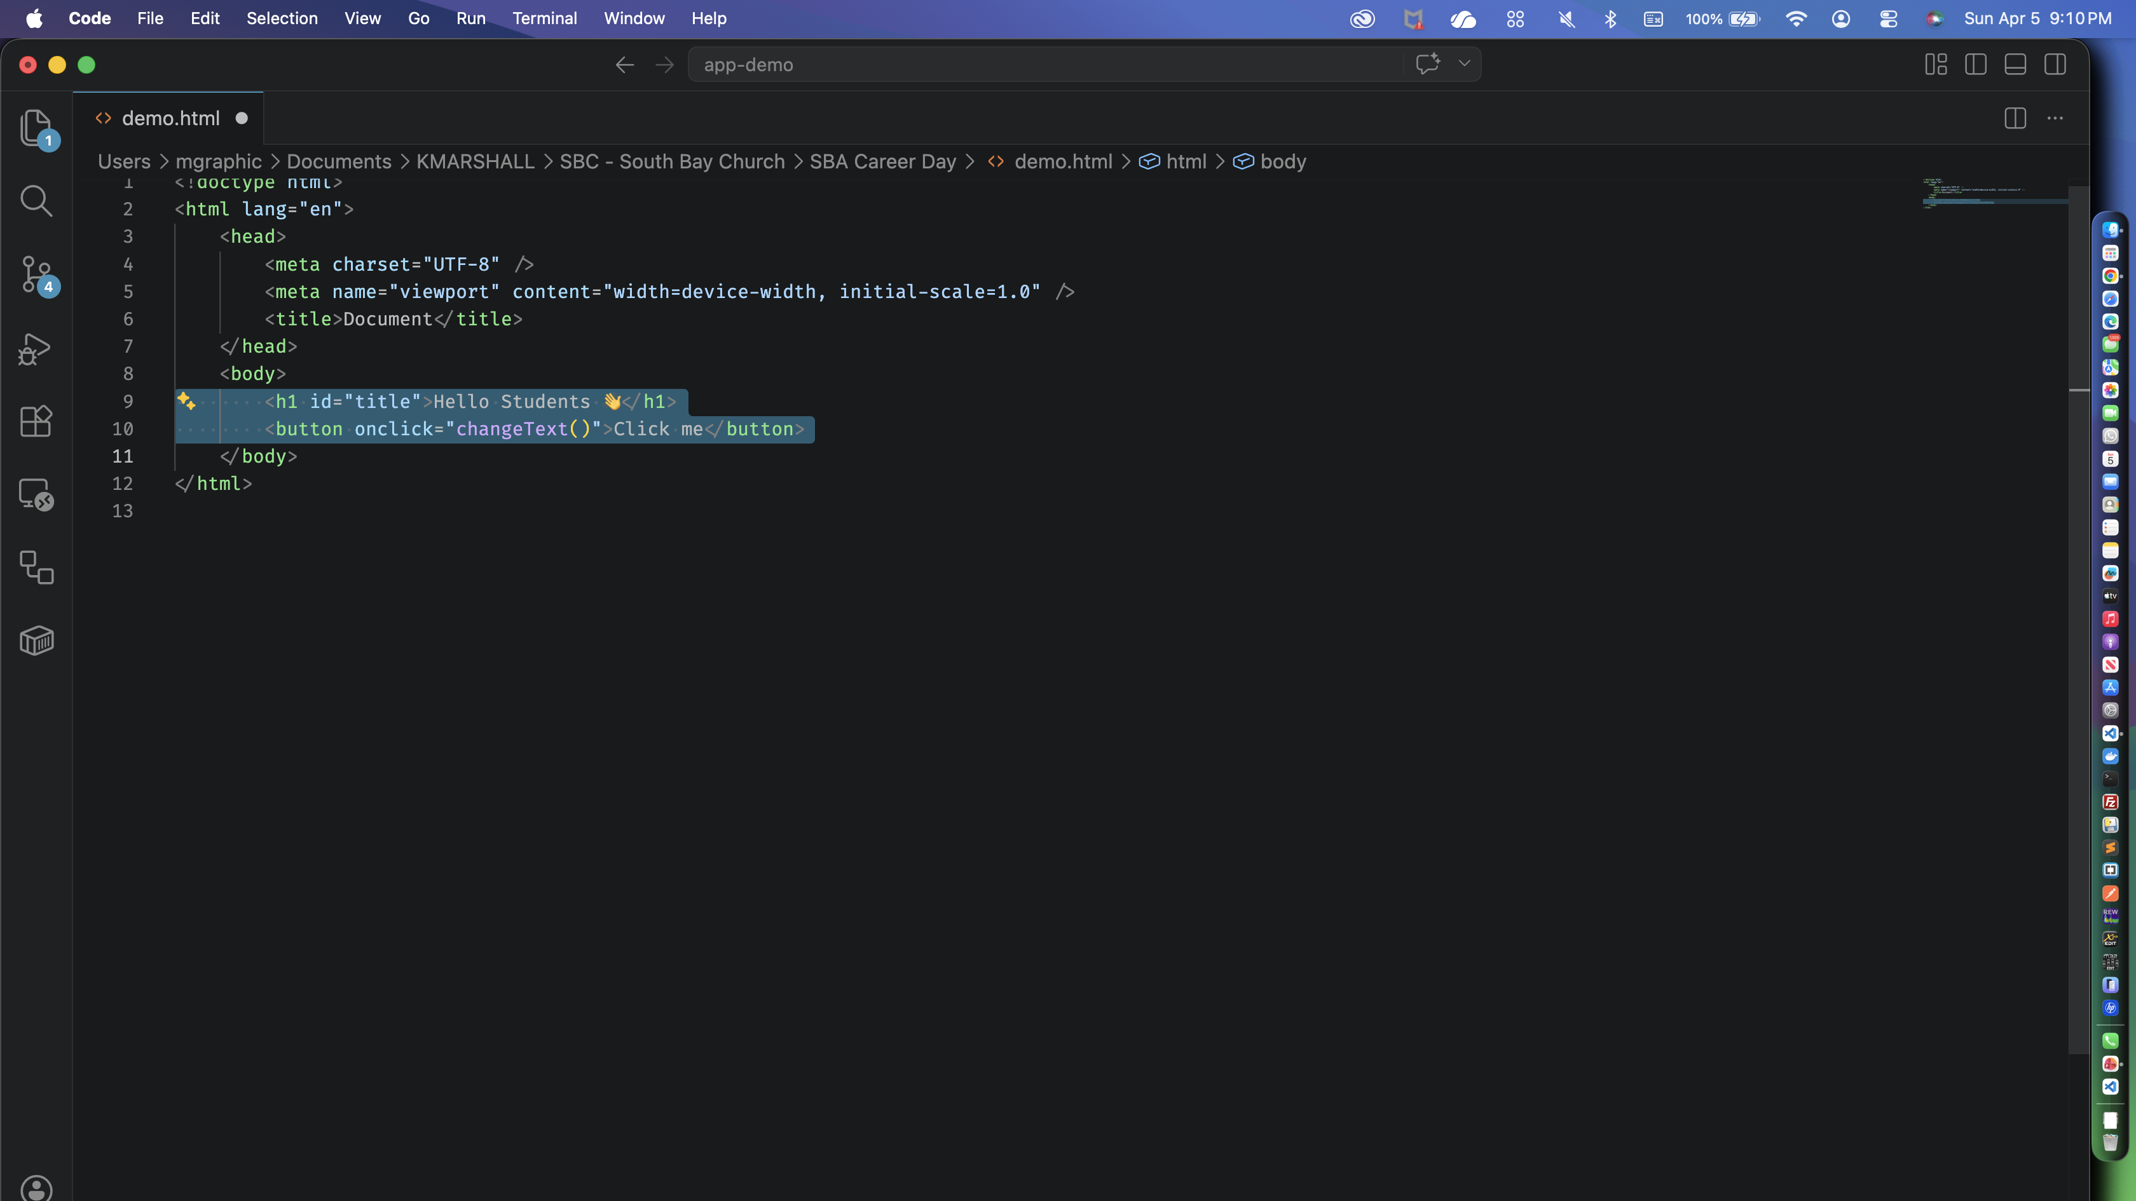

Slide 12
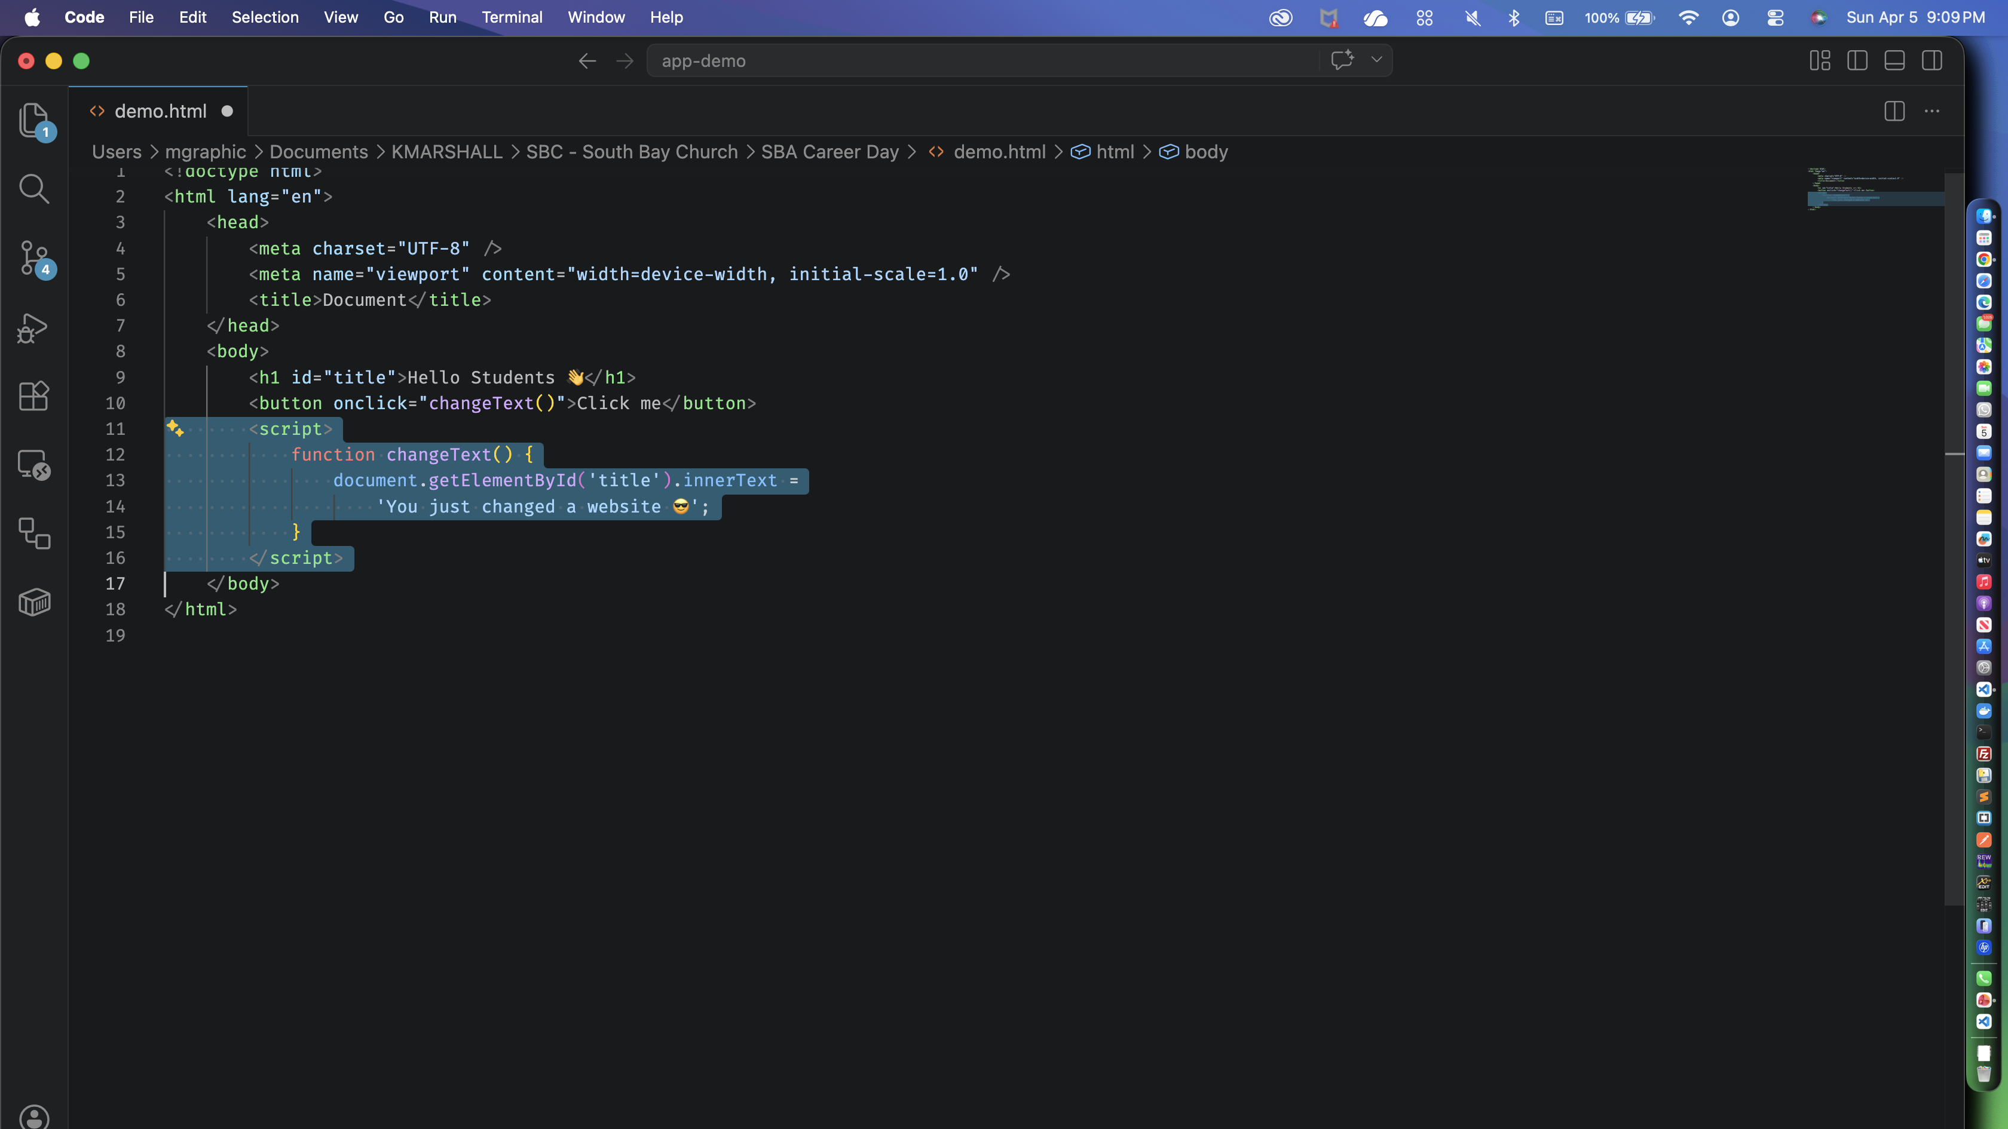

Slide 13
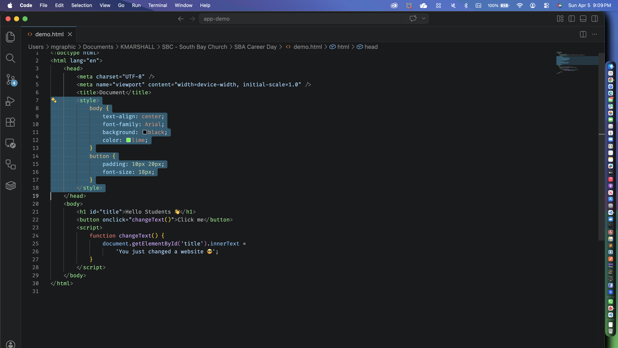

Slide 14
Game Time
Frontend vs Backend
FRONTEND
BACKEND
Login system?

Slide 15
Game Time
Frontend vs Backend
FRONTEND
BACKEND
Button color?

Slide 16
Game Time
Frontend vs Backend
FRONTEND
BACKEND
Animations?

Slide 17
Game Time
Frontend vs Backend
FRONTEND
BACKEND
Saving data?

Slide 18
Why This Career?
Good pay
Remote work
Creative freedom
Build your ideas

Slide 19
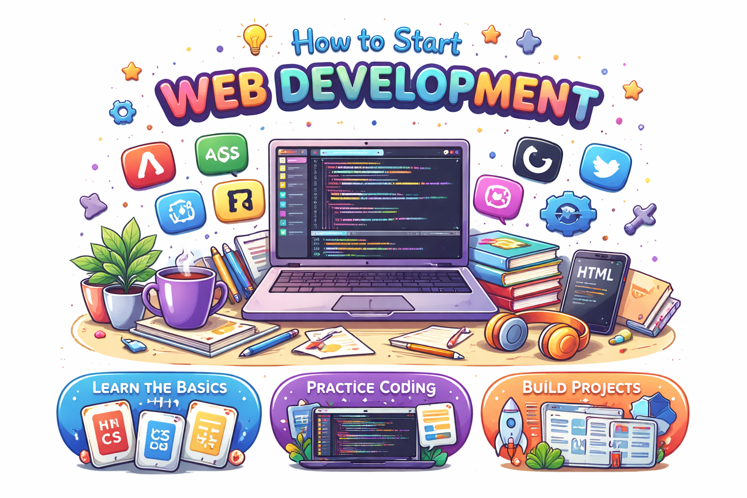
How to Start
HTML + CSS
JavaScript
Projects
GitHub
Deploy

Slide 20
Reality
No degree required
Start now
6–12 months possible

Slide 21
Q&A
Ask me anything
?

Slide 22

Final Thought
The only difference is... you start

